Slide 1
Naming

Slide 2
Introduction
Names play a very important role in all computer systems.
They are used to share resources, to uniquely identify entities, to refer to locations, and more.
An important issue with naming is that a name can be resolved to the entity it refers to.
Name resolution allows a process to access the named entity.
To resolve names, it is necessary to implement a naming system.
The difference between naming in distributed systems and non distributed systems lies in the way naming systems are implemented.

Slide 3
In a distributed system, the implementation of a naming system is itself often distributed across multiple machines.
How this distribution is done plays a key role in the efficiency and scalability of the naming system

Slide 4
Names, Identifiers, and Addresses
A name in a distributed system is a string of bits or characters that is used to refer to an entity.
An entity in a distributed system can be practically anything.
Ex: resources such as hosts, printers, disks, and files, processes, users, mailboxes, newsgroups, Web pages, graphical windows, messages, network connections, and so on.

Slide 5
Entities can be operated on
To operate on an entity, it is necessary to access it, for which we need an access point.
An access point is yet another, but special, kind of entity in a distributed system.
The name of an access point is called an address. The address of an access point of an entity is also simply called an address of that entity

Slide 6
An entity can offer more than one access point.
For ex telephone can be viewed as an access point of a person, whereas the telephone number corresponds to an address.
In a distributed system, a typical example of an access point is a host running a specific server, with its address formed by an IP address and port number
An entity may change its access points in the course of time.
For example, when a mobile computer moves to another location, it is often assigned a different IP address than the one it had before.

Slide 7
An address is a special kind of name: it refers to an access point of an entity.
Because an access point is tightly associated with an entity, use the address of an access point as a regular name for the associated entity
an entity may easily change an access point, or an access point may be reassigned to a different entity.
If an address is used to refer to an entity, we will have an invalid reference the instant the access point changes or is reassigned to another entity.
Therefore, it is much better to let a service be known by a separate name independent of the address of the associated server

Slide 8
if an entity offers more than one access point, it is not clear which address to use as a reference.
For instance, many organizations distribute their Web service across several servers. If we would use the addresses of those servers as a reference for the Web service, it is not obvious which address should be chosen as the best one.
much better solution is to have a single name for the Web service independent from the addresses of the different Web servers.
name for an entity that is independent from its addresses is often much easier and more flexible to use. Such a name is called location independent

Slide 9
there are other types of names used to uniquely identify an entity.
A true identifier is a name that has the following properties
An identifier refers to at most one entity.
Each entity is referred to by at most one identifier.
An identifier always refers to the same entity
By using identifiers, it becomes much easier to unambiguously refer to an entity
if an address can be reassigned to a different entity, we cannot use an address as an identifier.

Slide 10
Addresses and identifiers are two important types of names that are each used for very different purposes
how do we resolve names and identifiers to addresses?
a naming system maintains a name-to-address binding which in its simplest form is just a table of (name, address) pairs.
In distributed systems that span large networks and for which many resources need to be named, a centralized table is not going to work.
a name is decomposed into several parts such asJtp.cs.vu.nl and that name resolution takes place through a recursive lookup of those parts.

Slide 11
For example, a client needing to know the address of the FTP server named by jtp.cs.vu.nl
first resolve nl to find the server N'Stnl) responsible for names that end with nl, after which the rest of the name is passed to server NS(nl).
This server may then resolve the name vu to the server NStvu.ni) responsible for names that end with vu.nl who can further handle the remaining namejtp.cs.
Eventually, this leads torouting the name resolution request as: NS(.) ~ NS(nl) ~ NS(vu.nl) ~ address ofjtp.cs.vu.nl
where NS(.) denotes the server that can return the address of NS(nl), also known as the root server.
NS(vu.nl) will return the actual address of the FTP server.

Slide 12
different classes of naming
Flat Naming
Structured Naming
Attribute based naming

Slide 13
Flat Naming
Identifiers are convenient to uniquely represent entities.
In many cases, identifiers are simply random bit strings. Which are refer to as unstructured, or flat names.
An important property of such a name is that it does not contain any information whatsoever on how to locate the access point of its associated entity.
Simple solutions
Home based Approaches
Distributed Hash Tables
Hierarchical Approaches

Slide 14
Simple solutions
Two simple solutions for locating an entity
Both solutions are applicable only to local-area networks
Broadcasting and Multicasting
Forwarding Pointers

Slide 15
Broadcasting and Multicasting
Broadcasting :a machine broadcasts a packet on the local network asking who is the owner of a given IP address.
When the message arrives at a machine, the receiver checks whether it should listen to the requested IP address.
If so, it sends a reply packet containing
Broadcasting works only in LANs
Too much load on Network
Too much load on machines that can’t answer

Slide 16
Multicasting: only a restricted group of hosts receives the request
Multicasting can also be used to locate entities in point-to-point networks.
For example, the Internet supports network-level multicasting by allowing hosts to join a specific multicast group
Such groups are identified by a multicast address.
When a host sends a message to a multicast address, the network layer provides a best-effort service to deliver that message to all group members.

Slide 17
Multicasting
Possible in LAN hardware
not well supported at IP layer
Can use to find a nearest replica

Slide 18
Forwarding Pointers
When an entity moves, it leaves a pointer to where it went. Dereferencing can be made transparent to client - follow the pointer chain
Update client's reference when location is found
Geographical scalability problems: – Long chains not fault tolerant – High latency when dereferencing
Need chain reduction mechanisms

Slide 19
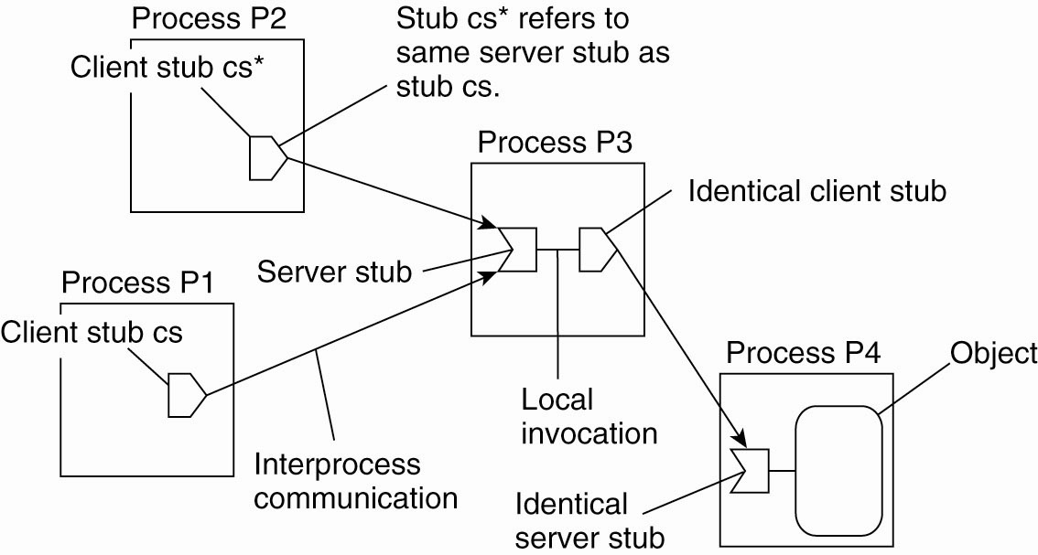
Forwarding Pointers (1)
Each forwarding pointer is implemented as a (client stub, server stub) pair
Fig: The principle of forwarding pointers using (client stub, server stub) pairs

Slide 20
Forwarding Pointers (2)
To short-cut a chain of (client stub, server stub) pairs, an object invocation carries the identification of the client stub from where that invocation was initiated.
A client-stub identification consists of the client's transport-level address, combined with a locally generated number to identify that stub.
When the invocation reaches the object at its current location, a response is sent back to the client stub where the invocation was initiated.
The current location is piggybacked with this response, and the client stub adjusts its companion server stub to the one in the object's current location

Slide 21
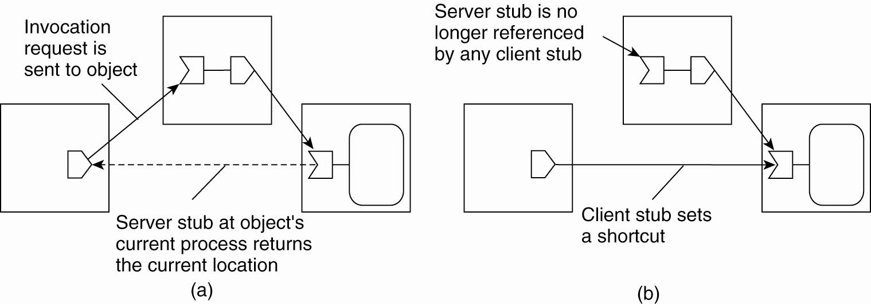
Forwarding Pointers (2)
Fig: Redirecting a forwarding pointer by storing a shortcut in a client stub.

Slide 22
Forwarding Pointers (3)
Fig: Redirecting a forwarding pointer by storing a shortcut in a client stub.

Slide 23
Home-Based Approaches
The use of broadcasting and forwarding pointers imposes scalability problems.
Broadcasting or multicasting is difficult to implement efficiently in large scale networks
long chains of forwarding pointers introduce performance problems and are susceptible to broken links.
Home based approaches keeps track of the current location of an entity
Ex: in Mobile IP

Slide 24
Home-Based Approaches
Each mobile host uses a fixed IP address.
All communication to that IP address is initially directed to the mobile host's home agent.
This home agent is located on the local-area network corresponding to the network address contained in the mobile host's IP address.
Whenever the mobile host moves to another network, it requests a temporary address that it can use for communication. This care-of address is registered at the home agent
When the home agent receives a packet for the mobile host, it looks up the host's current location.
If the host is on the current local network, the packet is simply forwarded. Otherwise, it is tunneled to the host's current location, that is, wrapped as data in an IP packet and sent to the care-of address. At the same time, the sender of the packet is informed of the host's current location

Slide 25
Fig: The principle of Mobile IP.

Slide 26
Problems with home-based approaches:
Home address has to be supported as long as entity lives
Home address is fixed - unnecessary burden if entity permanently moves
Poor geographical scalability (the entity may be next to the client)

Slide 27
Distributed Hash Tables
A distributed hash table (DHT) is a class of a decentralized DS that provides a lookup service similar to a hash table:
(key, value) pairs are stored in a DHT, and any participating node can efficiently retrieve the value associated with a given key.
Responsibility for maintaining the mapping from keys to values is distributed among the nodes, in such a way that a change in the set of participants causes a minimal amount of disruption.
This allows a DHT to scale to extremely large numbers of nodes and to handle continual node arrivals, departures, and failures.

Slide 28
DHTs characteristically emphasize the following properties:
Autonomy and decentralization: the nodes collectively form the system without any central coordination.
Fault tolerance: the system should be reliable (in some sense) even with nodes continuously joining, leaving, and failing.
Scalability: the system should function efficiently even with thousands or millions of nodes.

Slide 29
Chord is a protocol and algorithm for a peer to peer distributed hash table.
A distributed hash table stores key value pairs by assigning keys to different computers
a node will store the values for all the keys for which it is responsible.
Chord specifies how keys are assigned to nodes, and how a node can discover the value for a given key by first locating the node responsible for that key.

Slide 30
Hierarchical Approaches
In this scheme, a network is divided into a collection of domains.
There is a single top-level domain that spans the entire network.
Each domain can be subdivided into multiple, smaUser subdomains.
A lowest-level domain, called a leaf domain, typically corresponds to a local-area network in a computer network or a cell in a mobile telephone network.
Each domain D has an associated directory node dirt(D) that keeps track of the entities in that domain.
This leads to a tree of directory nodes. The directory node of the top-level domain, caUed the root (directory) node, knows about all entities.

Slide 31
To keep track of the whereabouts of an entity, each entity currently located in a domain D is represented by a location record in the directory node dir(D).
A location record for entity E in the directory node N for a leaf domain D contains the entity's current address in that domain.
the parent node of N' will store a location record for E containing only a pointer to N'.
Consequently, the root node will have a location record for each entity, where each location record stores a pointer to the directory node of the next lower-level sub domain where that record's associated entity is currently located.

Slide 32
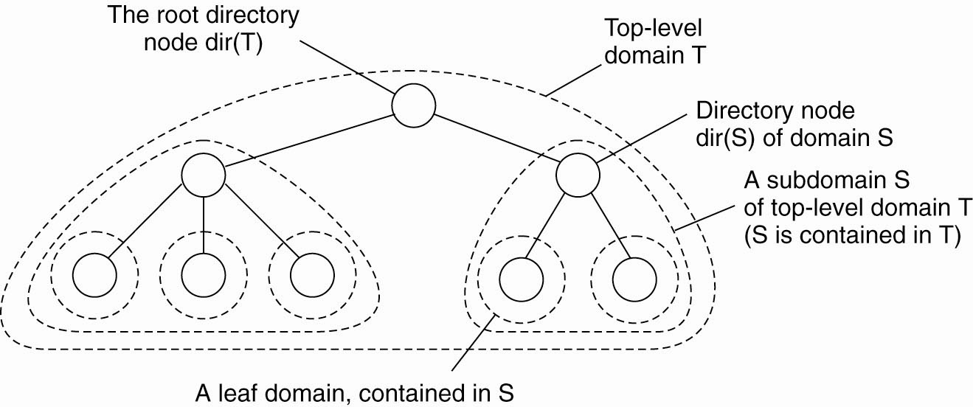
Fig: Hierarchical organization of a location service into domains, each having an associated directory node.

Slide 33
An entity may have multiple addresses, for example if it is replicated. If an entity has an address in leaf domain D1 and D2 respectively, then the directory node of the smallest domain containing both D 1 and D2, will have two pointers, one for each subdomain containing an address

Slide 34
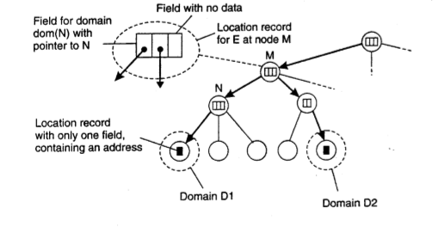
Fig: storing information of an entity having two addresses in different leaf domains

Slide 35
lookup operation
a client wishing to locate an entity E, issues a lookup request to the directory node of the leaf domain D in which the client resides.
If the directory node does not store a location record for the entity, then the entity is currently not located in D.
Consequently, the node forwards the request to its parent.
parent node represents a larger domain than its child.
If the parent also has no location record for E, the lookup request is forwarded to a next level higher, and soon.

Slide 36
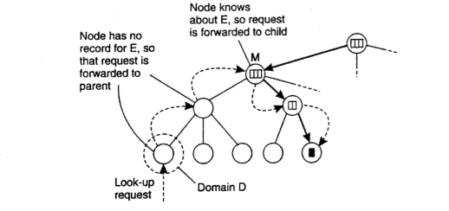
Fig: looking up a location in a hierarchically organized location service

Slide 37
STRUCTURED NAMING
Flat names are good for machines, but are generally not very convenient for humans to use.
structured names are composed from simple, human-readable names. file naming and host naming on the Internet follow this approach.
Now we’ll see structured names and the way that these names are resolved to addresses.

